Slide 1

Life Expectancy and Fertility Rates among nations
Regression Analysis of factors contributing to shorter lives and less children
Paul Gagliardi – COMP 4448

Slide 2
Research Question
Life Expectancy and Fertility rates are both used as metrics to help determine a countries level of development
Life Expectancy is generally always considered as the higher the better
Fertility Rates are sometimes lower in more developed countries
What factors are the most significant or correlated contributors to a higher life expectancy?
What could countries focus on if they wanted to improve life expectancy the most?
What factors are the most significant or correlated contributors to a higher fertility rate?

Slide 3
Dataset
Dataset pulled from a Kaggle Repository at https://www.kaggle.com/kacperk77/life-expectancy
Data information originates from https://data.worldbank.org/
Data comprised of two overlapping but different sets
Dataset 1 has 63 countries and 20 columns (17 input variables)
Dataset 2 has 138 countries and 13 columns (10 input variables)
Data reflects circa 2014 measurements of metrics

Slide 4
Dataset Variables
Country
Fertilityrate (Fertility rate, total (births per woman) 2014)
Lifeexp (Life expectancy at birth, total (years) 2014)
Literacyrate (Literacy rate, adult total (% of people ages 15 and above) 2014)
Homicidiesper100k (Homicidies per 100k people 2014)
Electricity (Electric power consumption (kWh per capita) 2014)
Schooling (Ave number of years of Schooling (years) 2014)
HIV.AIDS (Deaths per 1 000 live births HIV/AIDS (0-4 years) 2014)
Status (Economic development status of country)
Leastdeveloped (1 = country is considered as least developed; 0 = country is considered as developing or developed)
Wateraccess (Access to improved water sources (% of total population with access 2014)
Tuberculosis (Incidence of tuberculosis per 100,000 people 2014)
Inflation (Inflation, consumer prices (annual %) 2014)
Healthexppercapita (Average health expenditure per capita, PPP 2005-2014)
Internet (Individuals using the Internet (% of population) 2014)
Gdppercapita (GDP per capita, PPP (current international $) 2014)
CO2 (Average CO2 emissions (metric tons per capita) 2005-2014)
Forest (Forest area (% of land area) 2014)
Urbanpop (Urban population 2014)
Urbanpopgrowth (Average urban population growth (annual %) 2005-2014)
Notes:
Burgundy notes are only in DS1

Slide 5
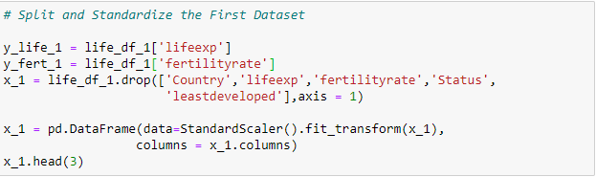
PreProcessing
Separating Life Expectancy and Fertility rate from data as independent output variables
Country, Status, and leastdeveloped do not convey significant information
Status and leastdeveloped are redundant, and reflect a subjective classification of a country rather than a measurement
All remaining input variables for both sets were numeric, and thus could be standardized
Notes:
Decision to standardize here arose more from desire to be able to interperate which factors were most significant

Slide 6
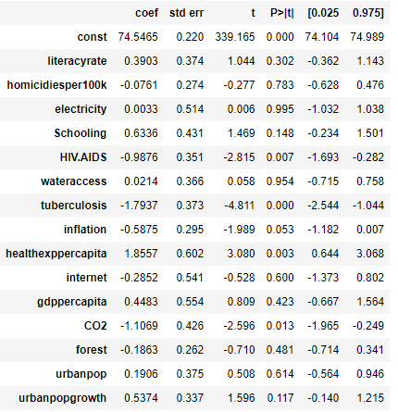
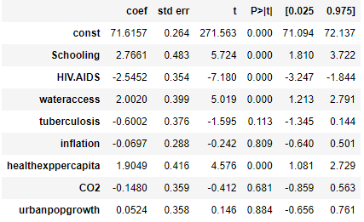
Initial Analysis – Life Expectancy
DATASet 1
Dataset 2

Slide 7
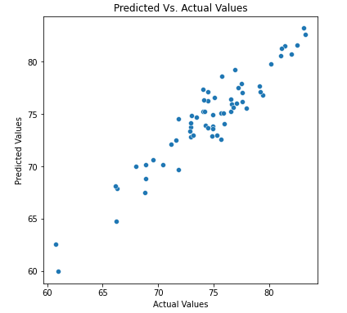
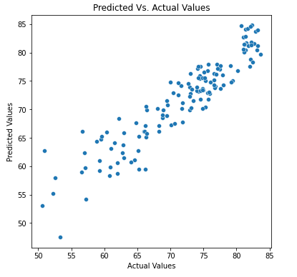
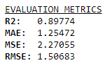
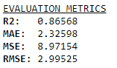
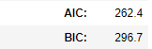
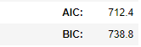
Initial Analysis – Life Expectancy Cont.
DATASet 1
Dataset 2
Significant factors:
HIV.AIDS
Tuberculosis
Healthexppercapita
CO2
Significant factors:
Schooling
HIV.AIDS
wateraccess
Healthexppercapita

Slide 8
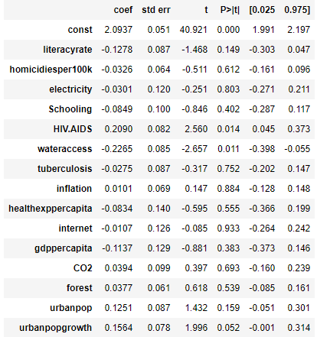
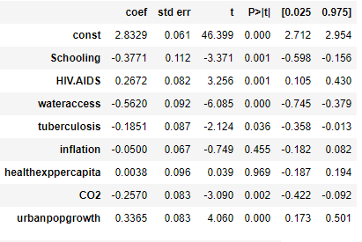
Initial Analysis – Fertility Rates
DATASet 1
Dataset 2

Slide 9
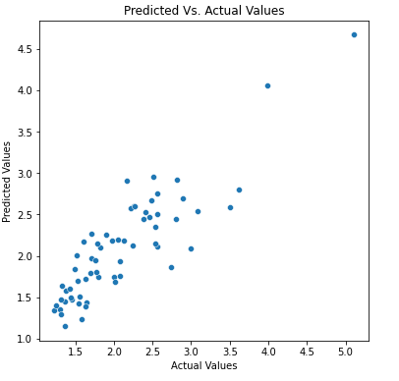
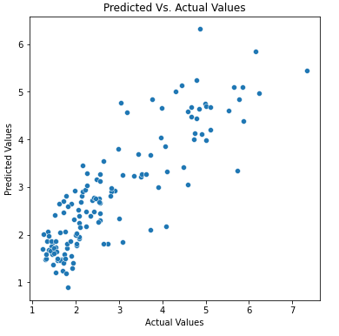
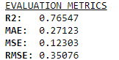
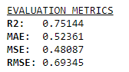
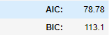
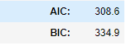
Initial Analysis – Fertility Rates Cont.
DATASet 1
Dataset 2
Significant factors:
HIV.AIDS
wateraccess
urbanpopgrowth
Significant factors:
Schooling
HIV.AIDS
wateraccess
tuberculosis
CO2
urbanpopgrowth

Slide 10
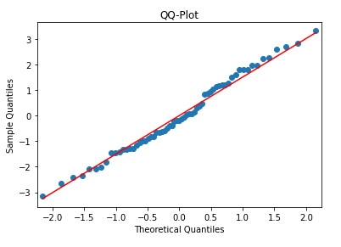
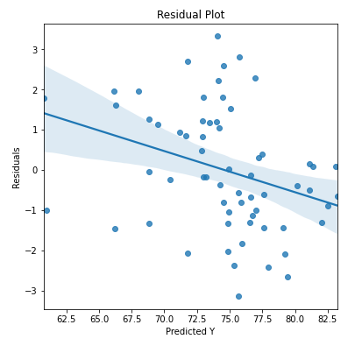
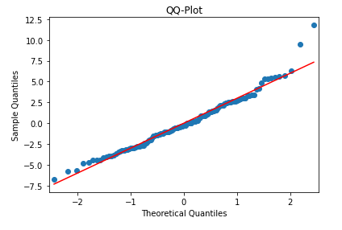
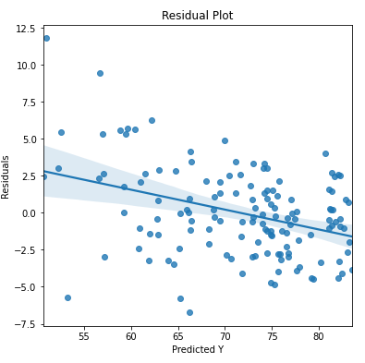
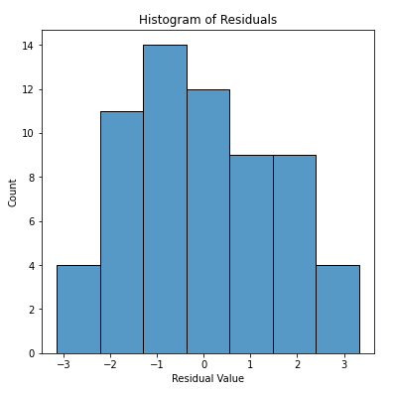
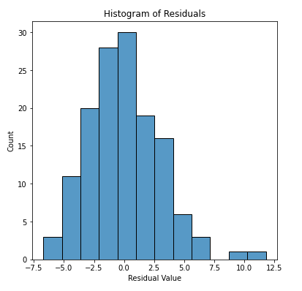
Regression Assumptions – Life Expectancy
DATASet 1
Dataset 2
Notes:
Residuals plot how negative residual skew at higher predicted y

Slide 11
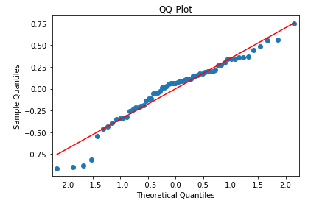
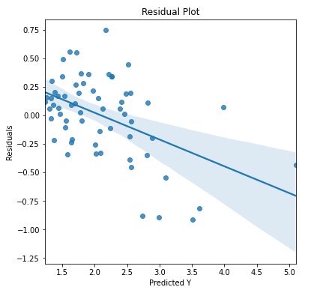
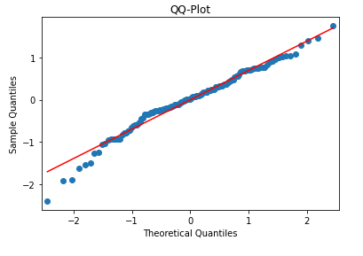
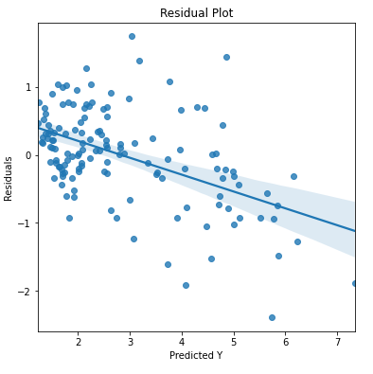
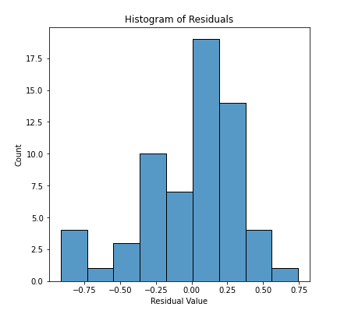
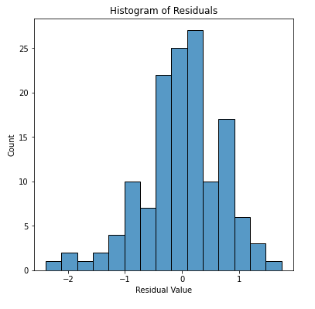
Regression Assumptions – Fertility Rates
DATASet 1
Dataset 2
Notes:
Residuals show higher grouping at low values of y, and more skew negative at higher values of y

Slide 12
Violations of Homoscedasticity
Life Expectancy
FerTility Rates
Results show that residuals are systematically more negative for higher values life expectancy
As developed/developing countries get basic needs met and solve issues such as HIV and tuberculosis, the significant indicators provide less importance to more developed countries and more of the secondary less significant indicators come into play
Residuals are tightly clustered with lower fertility rates, but become systematically lower with higher fertility rates
As countries develop, they converge to a fertility rate of roughly 2, whereas less developed countries have a wider range of fertility rates

Slide 13
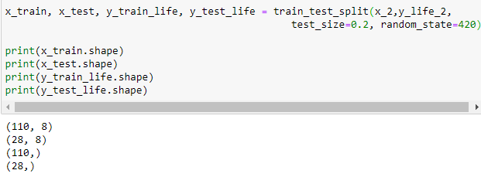
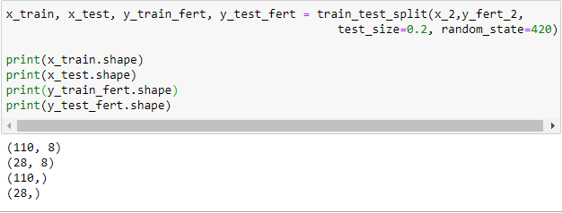
Splitting Data
Though the AIC, BIC, and R2 scores were inferior for Dataset 2, the set with more countries, there were as many or more significant factors than Dataset 1
Additionally, ML algorithms generally perform better on sets with more data

Slide 14
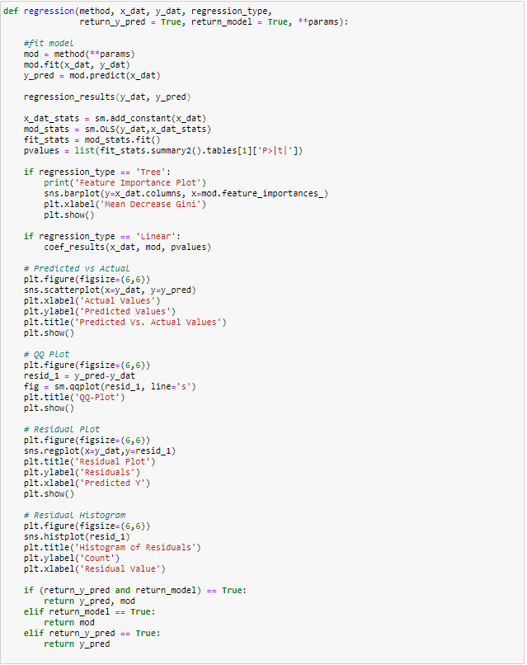
Mini Algo/Recursive Function

Slide 15
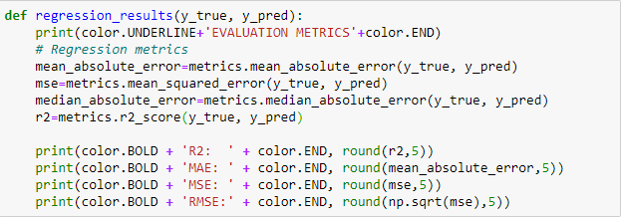
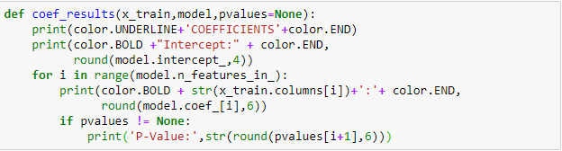
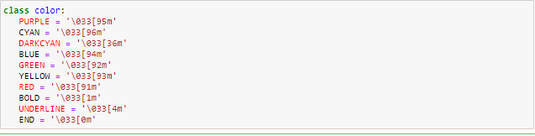
Mini Algo/Recursive Function

Slide 16
Life Expectancy Models

Slide 17
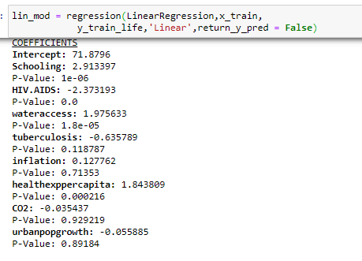
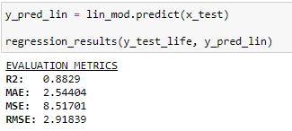
Model Selection: OLS

Slide 18
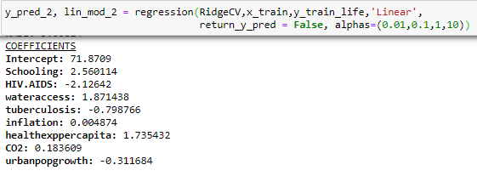
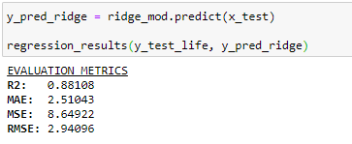
Model Selection: Ridge CV

Slide 19
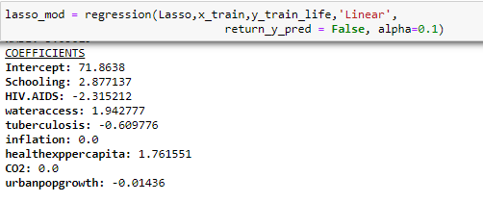
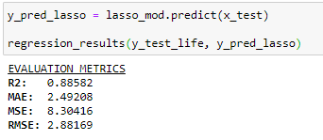
Model Selection: Lasso

Slide 20
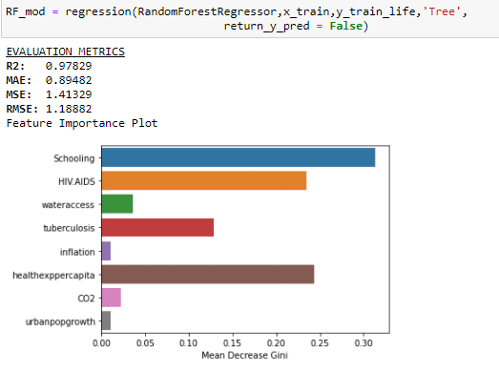
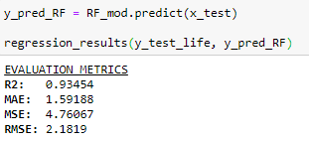
Model Selection: Random Forest

Slide 21
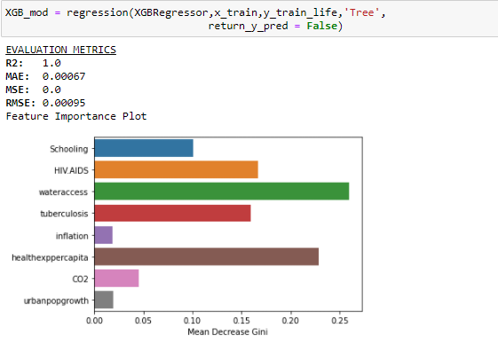
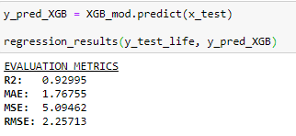
Model Selection: XGB

Slide 22
Fertility Models

Slide 23
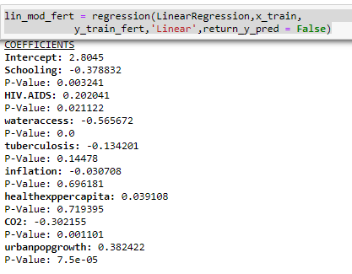
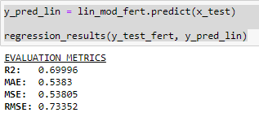
Model Selection: OLS

Slide 24
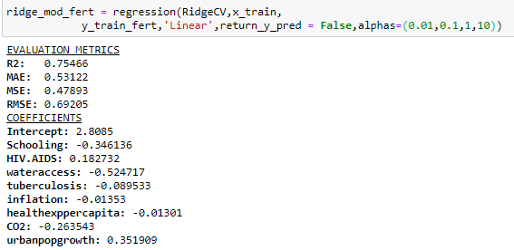
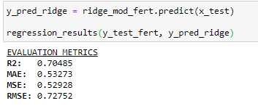
Model Selection: Ridge CV

Slide 25
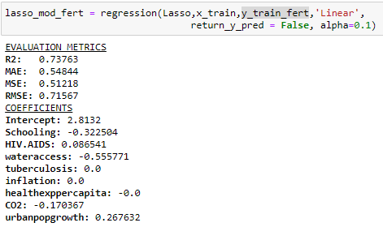

Model Selection: Lasso

Slide 26


Model Selection: Random Forest

Slide 27


Model Selection: XGB

Slide 28
Conclusions
Life Expectancy
FerTility Rates
XGB and Random Forest Regressors perform very well on this dataset
R2 both over 0.92
Most important features:
HIV.AIDS (neg)
Healthexppercapita (pos)
Tuberculosis (neg)
Wateraccess (pos)
Significant in XGB, but not in Random Forrest
Schooling (pos)
Most significant in Random Forrest, not as considered in XGB
Random Forest performs best on this analysis, followed by RidgeCV
Best R2 is 0.768
Most important features:
Schooling (neg)
Water access (neg)
Healthexppercaptia (neg) and CO2 (neg) somewhat significant, but not largely so
Models overfit slightly

Slide 29
Conclusions
Random Forrest had the most overall success with this dataset
Higher R2 scores on Life Expectancy RF and XGB Regressions indicate we can trust these results with a fairly high degree of confidence
Dataset not nearly large enough to benefit from linear regression
Heteroscedastic dataset, so regression results can be questioned. Likely that input variables are not completely independant

Slide 30
Thank You

